Slide 1
Foundations of Complex Software Architectures and Styles
Damian A. Tamburri, Ph.D.
damianandrew.tamburri@polimi.it
dtamburri@acm.org

Slide 2
Data-Intensive Middleware & NoSQL*
* Slides courtesy of Perry Hoekstra
Perficient, Inc. & Keith W. Hare - JCC Consulting, Inc. Convenor, ISO/IEC JTC1 SC32 WG3

Slide 3
Standard SQL
The following is a short, incomplete history of the SQL Standards – ISO/IEC 9075
1987 – Initial ISO/IEC Standard
1989 – Referential Integrity
1992 – SQL2
1995 SQL/CLI (ODBC)
1996 SQL/PSM – Procedural Language extensions
1999 – User Defined Types
2003 – SQL/XML
2008 – Expansions and corrections
2011 (or 2012) System Versioned and Application Time Period Tables

Slide 4
SQL Characteristics
Data stored in columns and tables
Relationships represented by data
Data Manipulation Language
Data Definition Language
Transactions
Abstraction from physical layer

Slide 5
SQL Physical Layer Abstraction
Applications specify what, not how
Query optimization engine
Physical layer can change without modifying applications
Create indexes to support queries
In Memory databases

Slide 6
Data Manipulation Language (DML)
Data manipulated with Select, Insert, Update, & Delete statements
Select T1.Column1, T2.Column2 … From Table1, Table2 … Where T1.Column1 = T2.Column1 …
Data Aggregation
Compound statements
Functions and Procedures
Explicit transaction control

Slide 7
Data Definition Language
Schema defined at the start
Create Table (Column1 Datatype1, Column2 Datatype 2, …)
Constraints to define and enforce relationships
Primary Key
Foreign Key
Etc.
Triggers to respond to Insert, Update , & Delete
Stored Modules
Alter …
Drop …
Security and Access Control

Slide 8
Transactions – ACID Properties
Atomic – All of the work in a transaction completes (commit) or none of it completes
Consistent – A transaction transforms the database from one consistent state to another consistent state. Consistency is defined in terms of constraints.
Isolated – The results of any changes made during a transaction are not visible until the transaction has committed.
Durable – The results of a committed transaction survive failures

Slide 9
SQL Database Examples
Commercial
IBM DB2
Oracle RDMS
Microsoft SQL Server
Sybase SQL Anywhere
Open Source (with commercial options)
MySQL
Ingres
Significant portions of the world’s economy use SQL databases!

Slide 10
History of the World, Part 1
Relational Databases – mainstay of business
Web-based applications caused spikes
Especially true for public-facing e-Commerce sites
Developers begin to front RDBMS with memcache or integrate other caching mechanisms within the application (ie. Ehcache)
Notes:
-> For the longest time (and still true today), the big relational database vendors such as Oracle, IBM, Sybase, and a lesser extent Microsoft were the mainstay of how data was stored.
-> During the Internet boom, startups looking for low-cost RDBMS alternatives turned to MySQL and PostgreSQL.
-> The ‘Slashdot Effect’ occurs when a popular website links to a smaller site, causing a massive increase in traffic.
-> Hooking your RDBMS to a web-based application was a recipe for headaches, they are OLTP in nature. Could have hundreds of thousands of visitors in a short-time span.
-> To mitigate, began to front the RDBMS with a read-only cache such as memcache to offload a considerable amount of the read traffic.
-> As datasets grew, the simple memcache/MySQL model (for lower-cost startups) started to become problematic.

Slide 11
Scaling Up
Issues with scaling up when the dataset is just too big
RDBMS were not designed to be distributed
Began to look at multi-node database solutions
Known as ‘scaling out’ or ‘horizontal scaling’
Different approaches include:
Master-slave
Sharding
Notes:
-> Best way to provide ACID and a rich query model is to have the dataset on a single machine.
-> However, there are limits to scaling up (Vertical Scaling).
-> Past a certain point, an organization will find it is cheaper and more feasible to scale out (horizontal scaling) by adding smaller, more inexpensive (relatively) servers rather than investing in a single larger server.
-> A number of different approaches to scaling out (Horizontal Scaling).
-> DBAs began to look at master-slave and sharding as a strategy to overcome some of these issues.

Slide 12
Scaling RDBMS – Master/Slave
Master-Slave
All writes are written to the master. All reads performed against the replicated slave databases
Critical reads may be incorrect as writes may not have been propagated down
Large data sets can pose problems as master needs to duplicate data to slaves

Slide 13
Scaling RDBMS - Sharding
Partition or Sharding:
Scales well for both reads and writes
Not transparent, application needs to be partition-aware
Can no longer have relationships/joins across partitions
Loss of referential integrity across shards
Notes:
-> Different sharding approaches:
-> Vertical Partitioning: Have tables related to a specific feature sit on their own server. May have to rebalance or reshard if tables outgrow server.
-> Range-Based Partitioning: When single table cannot sit on a server, split table onto multiple servers. Split table based on some critical value range.
-> Key or Hash-Based partitioning: Use a key value in a hash and use the resulting value as entry into multiple servers.
-> Directory-Based Partitioning: Have a lookup service that has knowledge of the partitioning scheme . This allows for the adding of servers or
changing the partition scheme without changing the application.
-> http://adam.heroku.com/past/2009/7/6/sql_databases_dont_scale
RI: table relationships must always be consistent.

Slide 14
Other ways to scale RDBMS
Multi-Master replication
INSERT only, not UPDATES/DELETES
No JOINs, thereby reducing query time
This involves de-normalizing data
In-memory databases
Notes:
-> The multi-master replication system is responsible for propagating data modifications made by each member to the rest of the group, and resolving any conflicts that might arise between concurrent changes made by different members.
-> For INSERT-only, data is versioned upon update.
-> Data is never DELETED, only inactivated.
-> JOINs are expensive with large volumes and don’t work across partitions.
-> Denormalization leads to even larger databases, reduces query time.
-> Consistency is the responsibility of the application.
-> In-memory databases have not caught on mainstream and regular RDBMS are more disk-intensive that memory-intensive. Vendors looking to fix this.

Slide 15
What is NoSQL?
Stands for Not Only SQL
Class of non-relational data storage systems
Usually do not require a fixed table schema nor do they use the concept of joins
All NoSQL offerings relax one or more of the ACID properties (will talk about the CAP theorem)
Notes:
-> NoSQL was a term coined by Eric Evans. He states that ‘… but the whole point of seeking alternatives is that you need to solve a problem that relational databases are a bad fit for. …
-> This is why people are continually interpreting nosql to be anti-RDBMS, it's the only rational conclusion when the only thing some of these projects share in common is that they are not relational databases.’
-> Emil Elfrem stated it is not a ‘NO’ SQL but more of a ‘Not Only” SQL.

Slide 16
Why NoSQL?
For data storage, an RDBMS cannot be the be-all/end-all
Just as there are different programming languages, need to have other data storage tools in the toolbox
A NoSQL solution is more acceptable to a client now than even a year ago
Think about proposing a Ruby/Rails or Groovy/Grails solution now versus a couple of years ago
Notes:
-> Too often as consultants, when we talk about data storage, we immediately reach for a relational database.
-> Relational databases offer a very good general purpose solution to many different data storage needs.
-> In other words, it is the safe choice and will work in many situations.
-> Need to have some knowledge of alternatives, if nothing else to know when a NoSQL solution needs further investigation.

Slide 17
How did we get here?
Explosion of social media sites (Facebook, Twitter) with large data needs
Rise of cloud-based solutions such as Amazon S3 (simple storage solution)
Just as moving to dynamically-typed languages (Ruby/Groovy), a shift to dynamically-typed data with frequent schema changes
Open-source community
Notes:
-> However, the people with the largest datasets (terrabyte/petabyte) began to realize that sharding was putting a bandage on their issues. The more aggressive thought leaders (Google, Facebook, Twitter) began to explore alternative ways to store data. This became especially true in 2008/2009.
-> These datasets have high read/write rates.
-> With the advent of Amazon S3, a large respected vendor made the statement that maybe is was okay to look at alternative storage solutions other that relational.
-> All of the NoSQL options with the exception of Amazon S3 (Amazon Dynamo) are open-source solutions. This provides a low-cost entry point to ‘kick the tires’.

Slide 18
NoSQL Definition
From www.nosql-database.org:
Next Generation Databases mostly addressing some of the points: being non-relational, distributed, open-source and horizontal scalable. The original intention has been modern web-scale databases. The movement began early 2009 and is growing rapidly. Often more characteristics apply as: schema-free, easy replication support, simple API, eventually consistent / BASE (not ACID), a huge data amount, and more.

Slide 19
NoSQL Products/Projects
http://www.nosql-database.org/ lists 122 NoSQL Databases
Cassandra
CouchDB
Hadoop & Hbase
MongoDB
StupidDB
Etc.

Slide 20
NoSQL Distinguishing Characteristics
Large data volumes
Google’s “big data”
Scalable replication and distribution
Potentially thousands of machines
Potentially distributed around the world
Queries need to return answers quickly
Mostly query, few updates
Asynchronous Inserts & Updates
Schema-less
ACID transaction properties are not needed – BASE
CAP Theorem
Open source development

Slide 21
BASE Transactions
Acronym contrived to be the opposite of ACID
Basically Available,
Soft state,
Eventually Consistent
Characteristics
Weak consistency – stale data OK
Availability first
Best effort
Approximate answers OK
Aggressive (optimistic)
Simpler and faster

Slide 22
Brewer’s CAP Theorem
A distributed system can support only two of the following characteristics:
Consistency
Availability
Partition tolerance
The slides from Brewer’s July 2000 talk do not define these characteristics.

Slide 23
Consistency
All nodes see the same data at the same time – Wikipedia
Client perceives that a set of operations has occurred all at once – Pritchett
More like Atomic in ACID transaction properties

Slide 24
Availability
node failures do not prevent survivors from continuing to operate – Wikipedia
Every operation must terminate in an intended response – Pritchett

Slide 25
Partition Tolerance
the system continues to operate despite arbitrary message loss – Wikipedia
Operations will complete, even if individual components are unavailable – Pritchett

Slide 26
NoSQL Database Types
Discussing NoSQL databases is complicated because there are a variety of types:
Column Store – Each storage block contains data from only one column
Document Store – stores documents made up of tagged elements
Key-Value Store – Hash table of keys

Slide 27
Other Non-SQL Databases
XML Databases
Graph Databases
Codasyl Databases
Object Oriented Databases
Etc…
Will not address these today

Slide 28
NoSQL Example: Column Store
Each storage block contains data from only one column
Example: Hadoop/Hbase
http://hadoop.apache.org/
Yahoo, Facebook
Example: Ingres VectorWise
Column Store integrated with an SQL database
http://www.ingres.com/products/vectorwise

Slide 29
Column Store Comments
More efficient than row (or document) store if:
Multiple row/record/documents are inserted at the same time so updates of column blocks can be aggregated
Retrievals access only some of the columns in a row/record/document

Slide 30
NoSQL Example: Document Store
Example: CouchDB
http://couchdb.apache.org/
BBC
Example: MongoDB
http://www.mongodb.org/
Foursquare, Shutterfly
JSON – JavaScript Object Notation

Slide 31
CouchDB JSON Example
{
"_id": "guid goes here",
"_rev": "314159",
"type": "abstract",
"author": "Keith W. Hare"
"title": "SQL Standard and NoSQL Databases",
"body": "NoSQL databases (either no-SQL or Not Only SQL)
are currently a hot topic in some parts of
computing.",
"creation_timestamp": "2011/05/10 13:30:00 +0004"
}

Slide 32
CouchDB JSON Tags
"_id"
GUID – Global Unique Identifier
Passed in or generated by CouchDB
"_rev"
Revision number
Versioning mechanism
"type", "author", "title", etc.
Arbitrary tags
Schema-less
Could be validated after the fact by user-written routine

Slide 33
NoSQL Examples: Key-Value Store
Hash tables of Keys
Values stored with Keys
Fast access to small data values
Example – Project-Voldemort
http://www.project-voldemort.com/
Linkedin
Example – MemCacheDB
http://memcachedb.org/
Backend storage is Berkeley-DB

Slide 34
Map Reduce
Technique for indexing and searching large data volumes
Two Phases, Map and Reduce
Map
Extract sets of Key-Value pairs from underlying data
Potentially in Parallel on multiple machines
Reduce
Merge and sort sets of Key-Value pairs
Results may be useful for other searches

Slide 35
Map Reduce
Map Reduce techniques differ across products
Implemented by application developers, not by underlying software

Slide 36
Map Reduce Patent
Google granted US Patent 7,650,331, January 2010
System and method for efficient large-scale data processing A large-scale data processing system and method includes one or more application-independent map modules configured to read input data and to apply at least one application-specific map operation to the input data to produce intermediate data values, wherein the map operation is automatically parallelized across multiple processors in the parallel processing environment. A plurality of intermediate data structures are used to store the intermediate data values. One or more application-independent reduce modules are configured to retrieve the intermediate data values and to apply at least one application-specific reduce operation to the intermediate data values to provide output data.

Slide 37
Storing and Modifying Data
Syntax varies
HTML
Java Script
Etc.
Asynchronous – Inserts and updates do not wait for confirmation
Versioned
Optimistic Concurrency

Slide 38
Retrieving Data
Syntax Varies
No set-based query language
Procedural program languages such as Java, C, etc.
Application specifies retrieval path
No query optimizer
Quick answer is important
May not be a single “right” answer

Slide 39
Open Source
Small upfront software costs
Suitable for large scale distribution on commodity hardware

Slide 40
NoSQL Summary
NoSQL databases reject:
Overhead of ACID transactions
“Complexity” of SQL
Burden of up-front schema design
Declarative query expression
Yesterday’s technology
Programmer responsible for
Step-by-step procedural language
Navigating access path

Slide 41
Summary
SQL Databases
Predefined Schema
Standard definition and interface language
Tight consistency
Well defined semantics
NoSQL Database
No predefined Schema
Per-product definition and interface language
Getting an answer quickly is more important than getting a correct answer

Slide 42
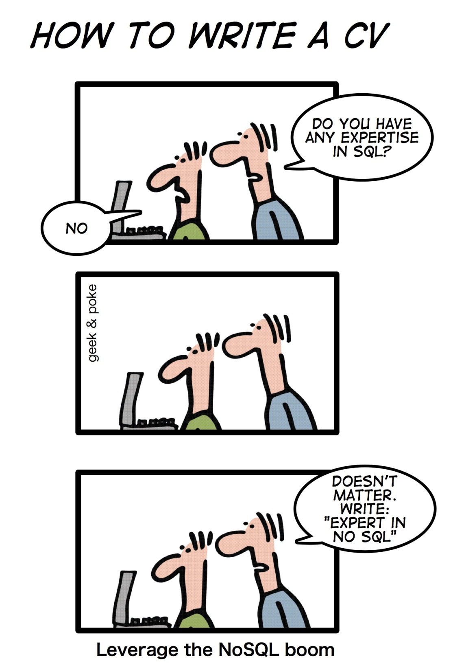

Slide 43


Bored yet?
10 min Break?

Slide 44
Dynamo and BigTable
Three major papers were the seeds of the NoSQL movement:
BigTable (Google)
Dynamo (Amazon)
Gossip protocol (discovery and error detection)
Distributed key-value data store
Eventual consistency
CAP Theorem (discuss in a sec ..)
Notes:
-> BigTable: http://labs.google.com/papers/bigtable.html
-> Dynamo: http://www.allthingsdistributed.com/2007/10/amazons_dynamo.html and http://www.allthingsdistributed.com/files/amazon-dynamo-sosp2007.pdf
-> Amazon and consistency
* http://www.allthingsdistributed.com/2010/02
* http://www.allthingsdistributed.com/2008/12

Slide 45
The Perfect Storm
Large datasets, acceptance of alternatives, and dynamically-typed data has come together in a perfect storm
Not a backlash/rebellion against RDBMS
SQL is a rich query language that cannot be rivaled by the current list of NoSQL offerings
Notes:
-> So you have reached a point where a read-only cache and write-based RDBMS isn’t delivering the throughput necessary to support a particular application.
-> You need to examine alternatives and what alternatives are out there.
-> The NoSQL databases are a pragmatic response to growing scale of databases and the falling prices of commodity hardware.
-> Most likely, 10 years from now, the majority of data is still stored in RDBMS.

Slide 46
CAP Theorem
Three properties of a system: consistency, availability and partitions
Theorem: “you can have at most two of these three properties for any shared-data system”
To scale out, you have to partition. That leaves either consistency or availability to choose from
In almost all cases, you would choose availability over consistency
Notes:
-> Proposed by Eric Brewer (talk on Principles of Distributed Computing July 2000).
-> Partitionability: divide nodes into small groups that can see other groups, but they can't see everyone. -> Consistency: write a value and then you read the value you get the same value back. In a partitioned system there are windows where that's not true. -> Availability: may not always be able to write or read. The system will say you can't write because it wants to keep the system consistent. -> To scale you have to partition, so you are left with choosing either high consistency or high availability for a particular system. You must find the right
overlap of availability and consistency.
-> Choose a specific approach based on the needs of the service. -> For the checkout process you always want to honor requests to add items to a shopping cart because it's revenue producing.
In this case you choose high availability. Errors are hidden from the customer and sorted out later. -> When a customer submits an order you favor consistency because several services--credit card processing, shipping and handling, reporting—
are simultaneously accessing the data.

Slide 47
Availability
Traditionally, thought of as the server/process available five 9’s (99.999 %).
However, for large node system, at almost any point in time there’s a good chance that a node is either down or there is a network disruption among the nodes.
Want a system that is resilient in the face of network disruption

Slide 48
Consistency Model
A consistency model determines rules for visibility and apparent order of updates.
For example:
Row X is replicated on nodes M and N
Client A writes row X to node N
Some period of time t elapses.
Client B reads row X from node M
Does client B see the write from client A?
Consistency is a continuum with tradeoffs
For NoSQL, the answer would be: maybe
CAP Theorem states: Strict Consistency can't be achieved at the same time as availability and partition-tolerance.
Notes:
-> http://cloudera-todd.s3.amazonaws.com/nosql.pdf

Slide 49
Eventual Consistency
When no updates occur for a long period of time, eventually all updates will propagate through the system and all the nodes will be consistent
For a given accepted update and a given node, eventually either the update reaches the node or the node is removed from service
Known as BASE (Basically Available, Soft state, Eventual consistency), as opposed to ACID
Notes:
-> http://en.wikipedia.org/wiki/Eventual_consistency
-> http://www.allthingsdistributed.com/2008/12/eventually_consistent.html
The types of large systems based on CAP aren't ACID they are BASE (http://queue.acm.org/detail.cfm?id=1394128): * Basically Available - system seems to work all the time * Soft State - it doesn't have to be consistent all the time * Eventually Consistent - becomes consistent at some later time
Everyone who builds big applications builds them on CAP and BASE: Google, Yahoo, Facebook, Amazon, eBay, etc

Slide 50
What kinds of NoSQL
NoSQL solutions fall into two major areas:
Key/Value or ‘the big hash table’.
Amazon S3 (Dynamo)
Voldemort
Scalaris
Schema-less which comes in multiple flavors, column-based, document-based or graph-based.
Cassandra (column-based)
CouchDB (document-based)
Neo4J (graph-based)
HBase (column-based)
Notes:
-> Not an exhaustive list, just some of the more well-known.
-> HBase is the data storage solution for Hadoop.
-> Graph: is a network database that uses edges and nodes to represent and store data.
-> Document: views are stored as rows which are kept sorted by key. Can adapt to variations in document structure.

Slide 51
Key/Value
Pros:
very fast
very scalable
simple model
able to distribute horizontally
Cons:
- many data structures (objects) can't be easily modeled as key value pairs
Notes:
-> http://chariotsolutions.blogspot.com/2010/01/why-you-need-nosql-in-your-toolbox.html

Slide 52
Schema-Less
Pros:
- Schema-less data model is richer than key/value pairs
eventual consistency
many are distributed
still provide excellent performance and scalability
Cons:
- typically no ACID transactions or joins

Slide 53
Common Advantages
Cheap, easy to implement (open source)
Data are replicated to multiple nodes (therefore identical and fault-tolerant) and can be partitioned
Down nodes easily replaced
No single point of failure
Easy to distribute
Don't require a schema
Can scale up and down
Relax the data consistency requirement (CAP)
Notes:
-> As the data is written, the latest version is on at least one node. The data is then versioned/replicated to other nodes within the system.
-> Eventually, the same version is on all nodes.

Slide 54
What am I giving up?
joins
group by
order by
ACID transactions
SQL as a sometimes frustrating but still powerful query language
easy integration with other applications that support SQL
Notes:
-> No JDBC
-> Data integrity at the application layer

Slide 55
Cassandra
Originally developed at Facebook
Follows the BigTable data model: column-oriented
Uses the Dynamo Eventual Consistency model
Written in Java
Open-sourced and exists within the Apache family
Uses Apache Thrift as it’s API

Slide 56
Thrift
Created at Facebook along with Cassandra
Is a cross-language, service-generation framework
Binary Protocol (like Google Protocol Buffers)
Compiles to: C++, Java, PHP, Ruby, Erlang, Perl, ...
Notes:
-> http://incubator.apache.org/thrift/static/thrift-20070401.pdf
-> http://incubator.apache.org/thrift/
-> Thrift also created by Facebook engineers and donated to Apache

Slide 57
Searching
Relational
SELECT `column` FROM `database`,`table` WHERE `id` = key;
SELECT product_name FROM rockets WHERE id = 123;
Cassandra (standard)
keyspace.getSlice(key, “column_family”, "column")
keyspace.getSlice(123, new ColumnParent(“rockets”), getSlicePredicate());

Slide 58
Typical NoSQL API
Basic API access:
get(key) -- Extract the value given a key
put(key, value) -- Create or update the value given its key
delete(key) -- Remove the key and its associated value
execute(key, operation, parameters) -- Invoke an operation to the value (given its key) which is a special data structure (e.g. List, Set, Map .... etc).
Notes:
-> http://horicky.blogspot.com/2009/11/nosql-patterns.html

Slide 59
Data Model
Within Cassandra, you will refer to data this way:
Column: smallest data element, a tuple with a name and a value
:Rockets, '1' might return:
{'name' => ‘Rocket-Powered Roller Skates',
‘toon' => ‘Ready Set Zoom',
‘inventoryQty' => ‘5‘,
‘productUrl’ => ‘rockets\1.gif’}
Notes:
-> Have heard it referred to as a 4 or 5 dimensional hash table.

Slide 60
Data Model Continued
ColumnFamily: There’s a single structure used to group both the Columns and SuperColumns. Called a ColumnFamily (think table), it has two types, Standard & Super.
Column families must be defined at startup
Key: the permanent name of the record
Keyspace: the outer-most level of organization. This is usually the name of the application. For example, ‘Acme' (think database name).
Notes:
-> Keys have different numbers of columns, so the database can scale in an irregular way.
-> Simple and Super: super columns are columns within columns.
-> Refer to date by keyspace, a column family, a key, an optional super column, and a column.

Slide 61
Cassandra and Consistency
Talked previous about eventual consistency
Cassandra has programmable read/writable consistency
One: Return from the first node that responds
Quorom: Query from all nodes and respond with the one that has latest timestamp once a majority of nodes responded
All: Query from all nodes and respond with the one that has latest timestamp once all nodes responded. An unresponsive node will fail the node
Notes:
-> http://www.slideshare.net/julesbravo/cassandra-3125809
-> Have a good simple benchmark to show to demonstrate difference between Cassandra and MySQL

Slide 62
Cassandra and Consistency
Zero: Ensure nothing. Asynchronous write done in background
Any: Ensure that the write is written to at least 1 node
One: Ensure that the write is written to at least 1 node’s commit log and memory table before receipt to client
Quorum: Ensure that the write goes to node/2 + 1
All: Ensure that writes go to all nodes. An unresponsive node would fail the write

Slide 63
Consistent Hashing
Partition using consistent hashing
Keys hash to a point on a fixed circular space
Ring is partitioned into a set of ordered slots and servers and keys hashed over these slots
Nodes take positions on the circle.
A, B, and D exists.
B responsible for AB range.
D responsible for BD range.
A responsible for DA range.
C joins.
B, D split ranges.
C gets BC from D.
Notes:
-> http://senguptas.org/Documents/cassandra_cs349c_presentation.pdf

Slide 64
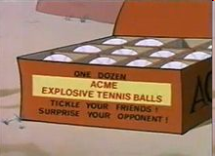


Domain Model
Design your domain model first
Create your Cassandra data store to fit your domain model
<Keyspace Name="Acme">
<ColumnFamily CompareWith="UTF8Type" Name="Rockets" />
<ColumnFamily CompareWith="UTF8Type" Name="OtherProducts" />
<ColumnFamily CompareWith="UTF8Type" Name="Explosives" />
…
</Keyspace>
Notes:
-> http://home.roadrunner.com/~tuco/looney/acme.html

Slide 65
Data Model
ColumnFamily: Rockets
Key
Value
1
Name
Value
name
Rocket-Powered Roller Skates
toon
Ready, Set, Zoom
inventoryQty
5
brakes
false
2
Name
Value
name
Little Giant Do-It-Yourself Rocket-Sled Kit
toon
Beep Prepared
inventoryQty
4
brakes
false
3
Name
Value
name
Acme Jet Propelled Unicycle
toon
Hot Rod and Reel
inventoryQty
1
wheels
1

Slide 66
Data Model Continued
Optional super column: a named list. A super column contains standard columns, stored in recent order
Say the OtherProducts has inventory in categories. Querying (:OtherProducts, '174927') might return:
{‘OtherProducts' => {'name' => ‘Acme Instant Girl', ..}, ‘foods': {...}, ‘martian': {...}, ‘animals': {...}}
In the example, foods, martian, and animals are all super column names. They are defined on the fly, and there can be any number of them per row. :OtherProducts would be the name of the super column family.
Columns and SuperColumns are both tuples with a name & value. The key difference is that a standard Column’s value is a “string” and in a SuperColumn the value is a Map of Columns.

Slide 67
Data Model Continued
Columns are always sorted by their name. Sorting supports:
BytesType
UTF8Type
LexicalUUIDType
TimeUUIDType
AsciiType
LongType
Each of these options treats the Columns' name as a different data type

Slide 68
Bored yet?
10 min Break?

Slide 69
For Example: Hector
Leading Java API for Cassandra
Sits on top of Thrift
Adds following capabilities
Load balancing
JMX monitoring
Connection-pooling
Failover
JNDI integration with application servers
Additional methods on top of the standard get, update, delete methods.
Under discussion
hooks into Spring declarative transactions
Notes:
-> Open-source at GitHub
-> Lead developer is Ran Tavoy

Slide 70
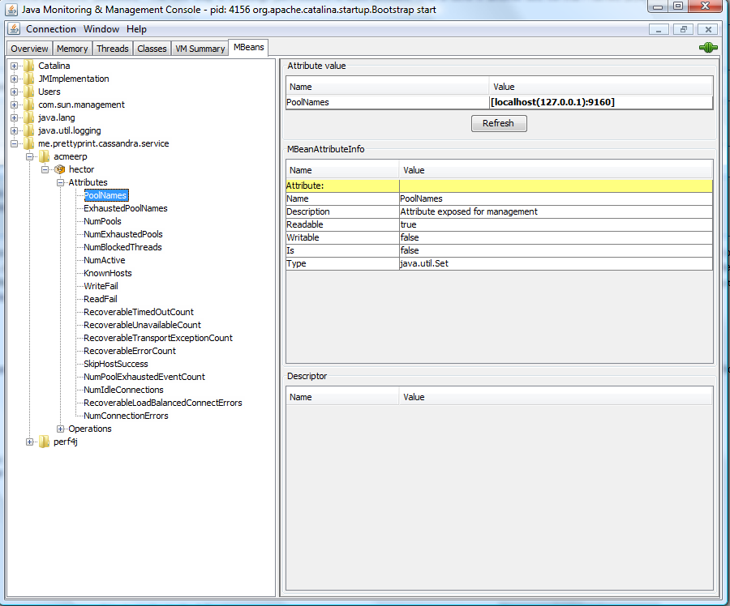
For Example: Hector and JMX
Notes:
-> Using JConsole

Slide 71
Code Examples: Tomcat Configuration
Tomcat context.xml
<Resource name="cassandra/CassandraClientFactory"
auth="Container"
type="me.prettyprint.cassandra.service.CassandraHostConfigurator"
factory="org.apache.naming.factory.BeanFactory"
hosts="localhost:9160"
maxActive="150"
maxIdle="75" />
J2EE web.xml
<resource-env-ref>
<description>Object factory for Cassandra clients.</description>
<resource-env-ref-name>cassandra/CassandraClientFactory</resource-env-ref-name>
<resource-env-ref-type>org.apache.naming.factory.BeanFactory</resource-env-ref-type>
</resource-env-ref>

Slide 72
Code Examples: Spring Configuration
Spring applicationContext.xml
<bean id="cassandraHostConfigurator“
class="org.springframework.jndi.JndiObjectFactoryBean">
<property name="jndiName">
<value>cassandra/CassandraClientFactory</value></property>
<property name="resourceRef"><value>true</value></property>
</bean>
<bean id="inventoryDao“
class="com.acme.erp.inventory.dao.InventoryDaoImpl">
<property name="cassandraHostConfigurator“
ref="cassandraHostConfigurator" />
<property name="keyspace" value="Acme" />
</bean>

Slide 73
Code Examples: Cassandra Get Operation
try {
cassandraClient = cassandraClientPool.borrowClient();
// keyspace is Acme
Keyspace keyspace = cassandraClient.getKeyspace(getKeyspace());
// inventoryType is Rockets
List<Column> result = keyspace.getSlice(Long.toString(inventoryId), new ColumnParent(inventoryType), getSlicePredicate());
inventoryItem.setInventoryItemId(inventoryId);
inventoryItem.setInventoryType(inventoryType);
loadInventory(inventoryItem, result);
} catch (Exception exception) {
logger.error("An Exception occurred retrieving an inventory item", exception);
} finally {
try {
cassandraClientPool.releaseClient(cassandraClient);
} catch (Exception exception) {
logger.warn("An Exception occurred returning a Cassandra client to the pool", exception);
}
}
Notes:
-> The purpose of these two slides is not to teach how to do Cassandra/Hector programming but to show how much programming needs to be done versus Hibernate
-> Back in the good old days of JDBC programming

Slide 74
Code Examples: Cassandra Update Operation
try {
cassandraClient = cassandraClientPool.borrowClient();
Map<String, List<ColumnOrSuperColumn>> data = new HashMap<String, List<ColumnOrSuperColumn>>();
List<ColumnOrSuperColumn> columns = new ArrayList<ColumnOrSuperColumn>();
// Create the inventoryId column.
ColumnOrSuperColumn column = new ColumnOrSuperColumn();
columns.add(column.setColumn(new Column("inventoryItemId".getBytes("utf-8"), Long.toString(inventoryItem.getInventoryItemId()).getBytes("utf-8"), timestamp)));
column = new ColumnOrSuperColumn();
columns.add(column.setColumn(new Column("inventoryType".getBytes("utf-8"), inventoryItem.getInventoryType().getBytes("utf-8"), timestamp)));
….
data.put(inventoryItem.getInventoryType(), columns);
cassandraClient.getCassandra().batch_insert(getKeyspace(), Long.toString(inventoryItem.getInventoryItemId()), data, ConsistencyLevel.ANY);
} catch (Exception exception) {
…
}

Slide 75
Some Statistics
Facebook Search
MySQL > 50 GB Data
Writes Average : ~300 ms
Reads Average : ~350 ms
Rewritten with Cassandra > 50 GB Data
Writes Average : 0.12 ms
Reads Average : 15 ms
Notes:
-> http://static.last.fm/johan/nosql-20090611/cassandra_nosql.ppt

Slide 76
Some things to think about
Ruby on Rails and Grails have ORM baked in. Would have to build your own ORM framework to work with NoSQL.
Some plugins exist.
Same would go for Java/C#, no Hibernate-like framework.
A simple JDO framework does exist.
Support for basic languages like Ruby.
Notes:
-> http://github.com/PedroGomes/datanucleus-cassandra (JDO)
-> http://github.com/wolpert/grails-cassandra

Slide 77
Some more things to think about
Troubleshooting performance problems
Concurrency on non-key accesses
Are the replicas working?
No TOAD for Cassandra
though some NoSQL offerings have GUI tools
have SQLPlus-like capabilities using Ruby IRB interpreter.
Notes:
-> Taken from: http://www.claassen.net/geek/blog/2010/02/nosql-is-new-arcadia.html

Slide 78
Don’t forget about the DBA
It does not matter if the data is deployed on a NoSQL platform instead of an RDBMS.
Still need to address:
Backups & recovery
Capacity planning
Performance monitoring
Data integration
Tuning & optimization
What happens when things don’t work as expected and nodes are out of sync or you have a data corruption occurring at 2am?
Who you gonna call?
DBA and SysAdmin need to be on board
Notes:
-> Need to educate the DBA rather than going around them.

Slide 79
Where would I use it?
For most of us, we work in corporate IT and a LinkedIn or Twitter is not in our future
Where would I use a NoSQL database?
Do you have somewhere a large set of uncontrolled, unstructured, data that you are trying to fit into a RDBMS?
Log Analysis
Social Networking Feeds (many firms hooked in through Facebook or Twitter)
External feeds from partners (EAI)
Data that is not easily analyzed in a RDBMS such as time-based data
Large data feeds that need to be massaged before entry into an RDBMS
Notes:
http://www.infoq.com/articles/nosql-in-the-enterprise

Slide 80
Summary, up to this point...
Leading users of NoSQL datastores are social networking sites such as Twitter, Facebook, LinkedIn, and Digg.
To implement a single feature in Cassandra, Digg has a dataset that is 3 terabytes and 76 billion columns.
Not every problem is a nail and not every solution is a hammer.
Notes:
NoSQL has taken a field that was "dead" (database development) and suddenly brought it back to life.

Slide 81
Don’t Forget!
On Dec. 7th we will have our intermediate project revision!
Prepare a presentation:
20 mins + questions
You will HAVE TO expose, at least:
The architectural structures that you could see;
the decisions that were taken over the time of your study and the properties that these decisions imply and your rationale over these;
Document the style and provide a rationale for that style or elaborate if/how other styles apply;
Document an overview of the technologies involved and notations that describe the software architecture;
Notes:
I want you to spend time documenting the architecture for which you already gathered preliminary insights; document the structure; the decisions that were taken over time, the properties that these decisions imply and your rationale over those decisions; Document the style and provide a rationale why that style (or others, if in your opinion others apply) may be appropriate or not for the domain at hand; also document an overview of the technologies involved and provide statistics over the complexity and metrics that describe the software architecture

Slide 82

Questions?
Thanks!

Slide 83
Resources
Cassandra
http://cassandra.apache.org
Hector
http://wiki.github.com/rantav/hector
http://prettyprint.me
NoSQL News websites
http://nosql.mypopescu.com
http://www.nosqldatabases.com
High Scalability
http://highscalability.com
Video
http://www.infoq.com/presentations/Project-Voldemort-at-Gilt-Groupe
Notes:
Books:
-> CouchDB (O’Reilly)
-> Hadoop (O’Reilly)
-> MongoDB (O’Reilly Forthcoming)
-> Hadoop in Action (Manning Forthcoming)
-> CouchDB in Action (Manning Forthcoming)

